Slide 1
Comprehensive SEO Audit & Optimization for Organic Traffic Growth - Presented by Shabeeb Althaf M B Batch- MBT8

Slide 2


Company Selection
I selected the company Crimson Logic for this project.
Website- www.crimsonlogic.com
About Us
CrimsonLogic, part of the PSA Group, is a global technology company that digitalises and simplifies global trade for businesses and governments around the world through intuitive and delightful solutions.
With over 35 years of experience advancing trade facilitation, compliance, port operations, government services and logistics, we push the boundaries of technology with insightful innovation and deep domain expertise of global trade driven by customer-centricity at our core.
Having pioneered the world’s first single-window trade facilitation system, we continue to drive the digital transformation of global trade in over 40 countries with sustainable, impactful solutions for a more seamlessly connected world.

Slide 3
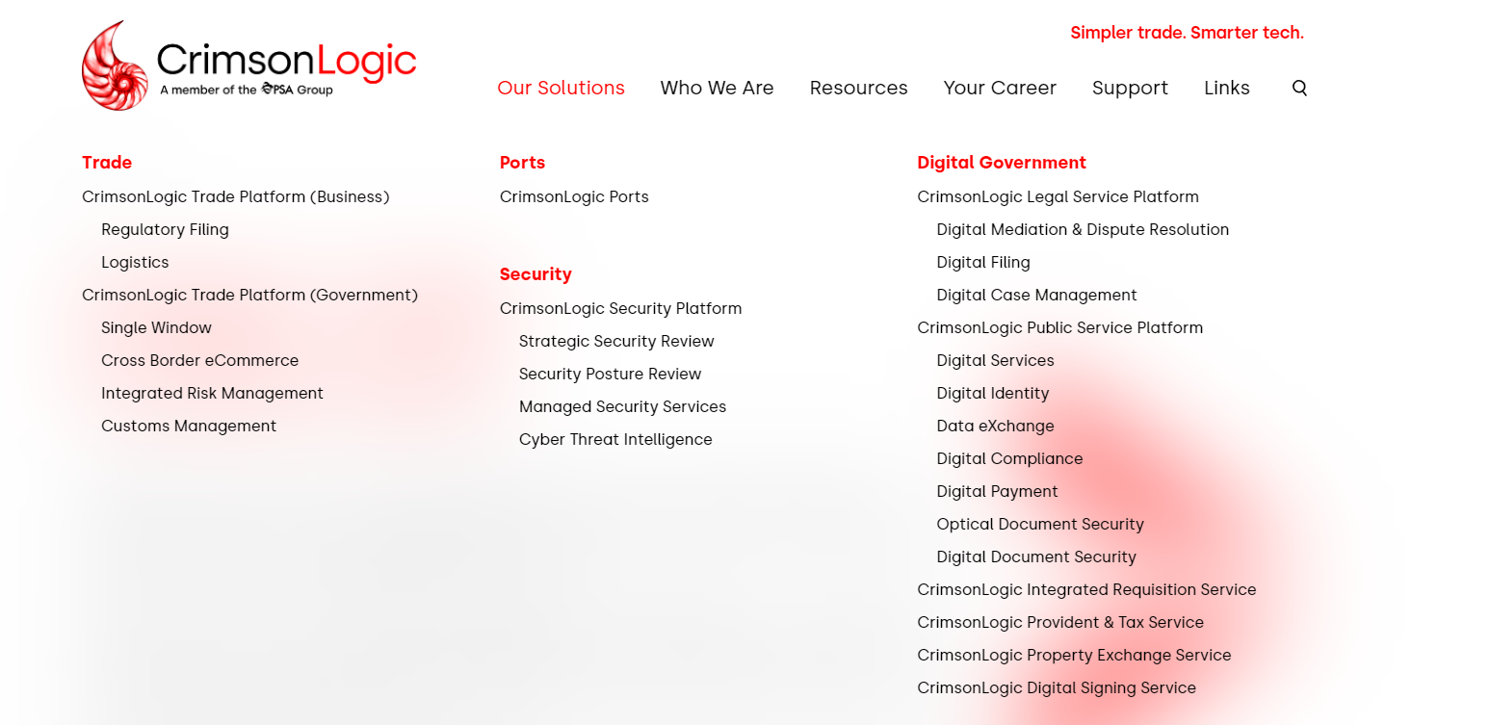
Services Offered

Slide 4
Project analysis slide 3
Topics Covered
Keyword Research
Technical SEO
On-Page SEO
Off-Page SEO
Content Audit
A technical SEO audit, also known as a technical site audit, is a review of your website's technical components to ensure it's optimized for search engines. It helps you identify and fix issues that could affect your website's search engine visibility and online presence.
An on-page SEO audit is a review of a website's elements to ensure they're optimized for search engines and user experience. It's like a health check for your website that can help you identify areas for improvement and growth.
Keyword research can help your content be more visible and get more traffic. Keyword audits can help you understand market trends, user behaviour and your competitors. This can help you refine your SEO strategy.
An SEO content strategy is a plan for creating and optimizing content to improve a website's search engine ranking and traffic. It includes a variety of tasks, such as keyword research, content creation, and promotion.
An off-page SEO audit examines the activities that take place outside of a website to determine its search engine ranking, credibility, and authority.

Slide 5

What is a SEO Audit?
An SEO audit is the process of evaluating how well your website is optimized for search engines. It identifies errors that can prevent your site from ranking well and opportunities that can help you gain more visibility.

Slide 6
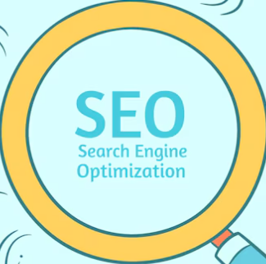
Project analysis slide 2
Project Analysis
Keyword Research
On-Page SEO
Off-Page SEO
Indexing and Crawlability
Technical SEO
User Experience

Slide 7
Project analysis slide 4
Tools Used
An effective SEO website audit is based on hard data about the technical health, traffic and backlinks profile of your website (and the website of your competitors)
Tasks
The five most important tools we used in the project is:
SEO Optimer: SEOOptimer is an online SEO auditing tool that evaluates websites based on factors like on-page SEO, usability, performance, links, and social media. It provides detailed reports and recommendations for improvement, helping businesses optimize their site's search engine rankings and overall digital presence for better performance and visibility..
Semrush: Semrush is a comprehensive digital marketing tool used for SEO, PPC, content marketing, and competitor analysis. It helps users improve online visibility by providing insights into keyword rankings, backlinks, site audits, and traffic analytics. Semrush also offers tools for optimizing social media strategies and tracking search engine performance..
Ubersuggest: Ubersuggest SEO Analyser is a tool that helps website owners improve their search engine rankings. It provides insights on keyword performance, backlinks, and site health, offering suggestions for optimization. With features like site audits and competitor analysis, it helps enhance on-page SEO and overall website performance.
GT Metrix: To analyse mobile speed test.
Bing Test: It is used to analyse mobile compatibility test.
Management Objectives
Project Objectives
Implementation Plan
Schedules
Customer Objectives
Resources
We will take a closer look at how to do a SEO audit using these tools in the next steps.

Slide 8
Project analysis slide 4
Initial Audit
Tasks
Initial Audit:
Select any company listed below and Conduct a comprehensive SEO audit of the selected website to identify current performance, strengths, and weaknesses.
Management Objectives
Project Objectives
Implementation Plan
Schedules
Customer Objectives
Resources

Slide 9
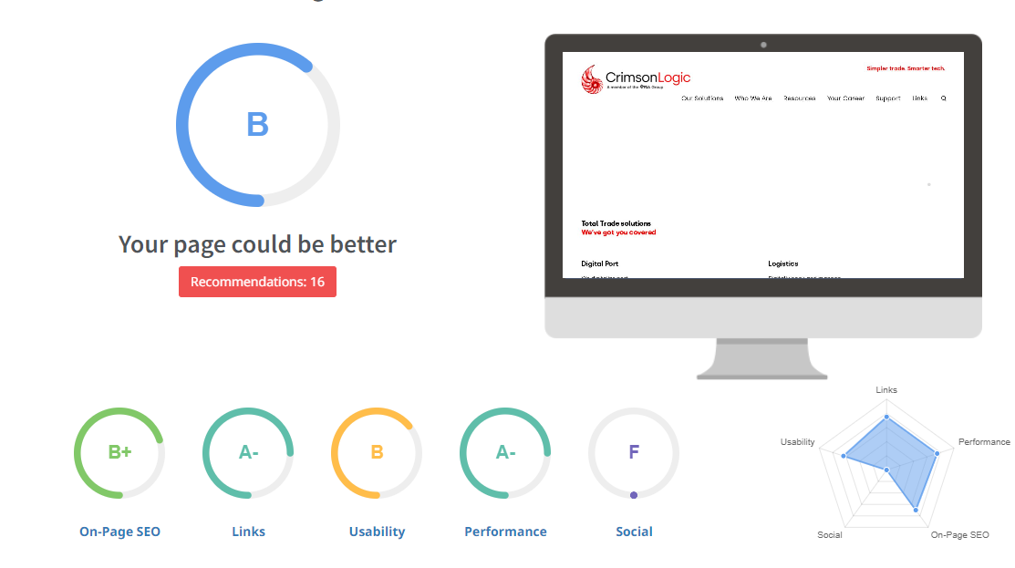
Project analysis slide 5
Current Performance
Observation:
This image showcases a comprehensive site audit for ‘crimsonlogic.com’, highlighting impressive metrics.
The dashboard reveals four key performance indicators, all marked in green, indicating excellent results.
The on-page SEO score is 74, organic monthly traffic stands at 12,659, organic keywords are 406, and backlinks total 27,396.
These metrics suggest that the website is performing exceptionally well in terms of SEO, traffic, and keyword optimization.
It has an overall website performance score of "B" with 16 recommendations for improvement.
The site excels in areas like On-Page SEO (B+) and Links (A-), indicating good optimization and backlink structure.
Usability is rated at "B", suggesting the user experience could be improved.
Performance is strong with an A-, but the Social category is a notable weakness, receiving an "F", implying poor social media integration or activity.
The clear visual representation makes it easy to understand the site’s strengths at a glance. Overall, this audit reflects a well-optimized and high-performing website.

Slide 10
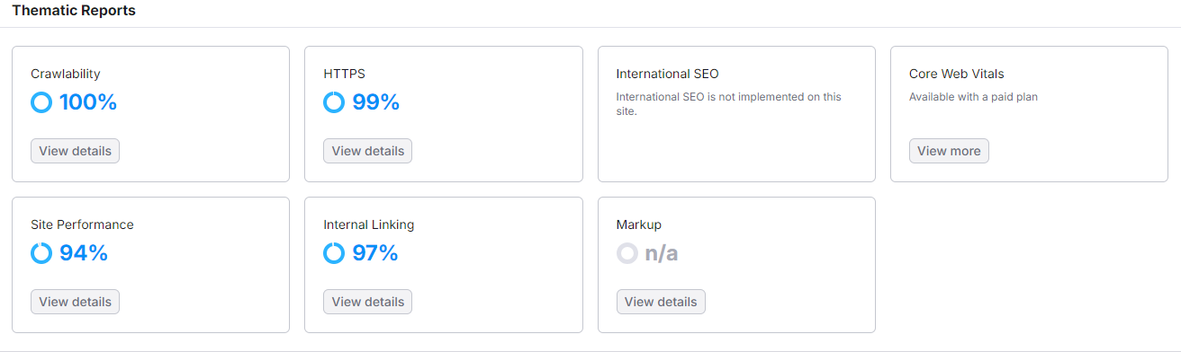
Project analysis slide 5
Strength
Observation:
It represents a thematic report showcasing various aspects of a website's performance.
The site has excellent crawlability at 100%, indicating that search engines can efficiently navigate its content.
HTTPS security is strong at 99%, ensuring safe user connections.
Internal linking is also robust at 97%, promoting good SEO practices.
Site performance, however, is slightly lower at 94%, suggesting room for optimization.
International SEO is not implemented, which may limit the site's reach to global audiences.
Core Web Vitals and mark-up are not fully evaluated, with the latter marked as "n/a." Overall, the site shows strong technical health.

Slide 11
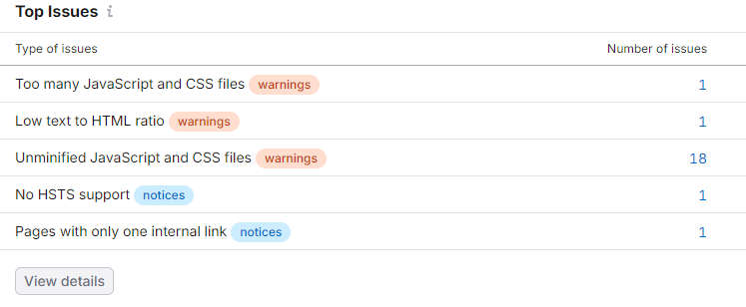
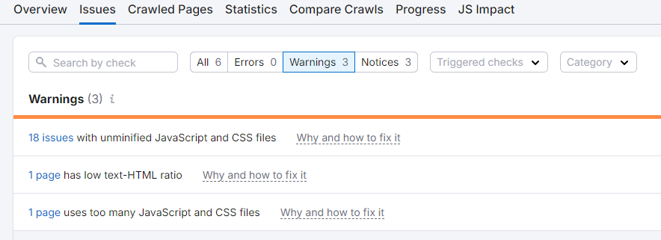
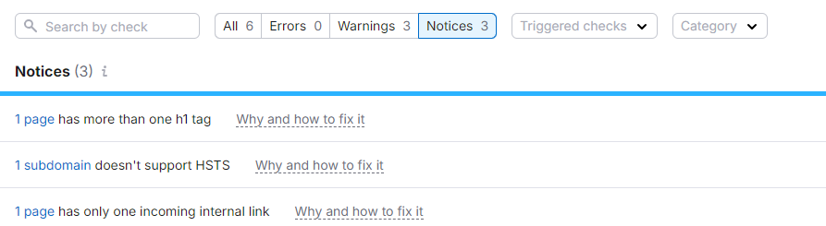
Project analysis slide 5
Weakness
Observation:
It provides a clear overview of a website’s diagnostic results, categorized into Errors, Warnings, and Notices and also highlights Key SEO issues on the website, such as too many JavaScript and CSS files, low text-to-HTML ratio, and un-minified JavaScript and CSS files.
It also notes the absence of HSTS support and pages with only one internal link.
Addressing these issues can significantly improve the site’s performance and security.
Impressively, there are no Errors, indicating a stable system.
However, the 20 Warnings suggest areas that need attention to prevent potential issues.
The 3 Notices are minor recommendations for best practices.
The color-coded bars and numerical values make it easy to understand the distribution and severity of these issues. This visual summary is particularly useful for developers and system administrators to quickly assess and prioritize their tasks, ensuring the website remains efficient and secure.

Slide 12
Project analysis slide 4
Keyword Research
Tasks
Keyword Research:
Identify relevant keywords with high search volume and low competition for the selected company products or services.
Analyze competitor keywords and strategies for the selected company website.
Management Objectives
Project Objectives
Implementation Plan
Schedules
Customer Objectives
Resources

Slide 13
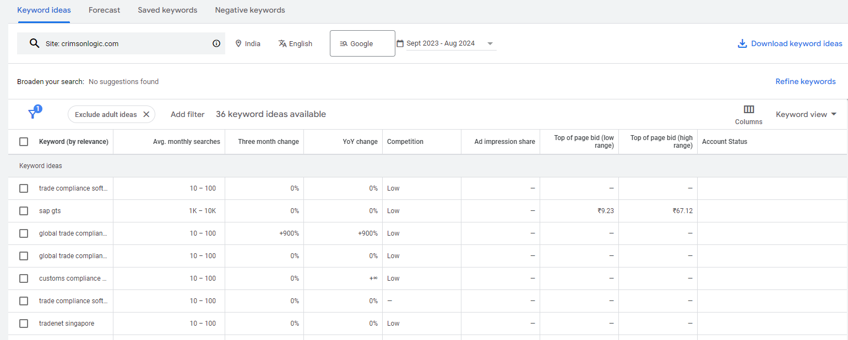
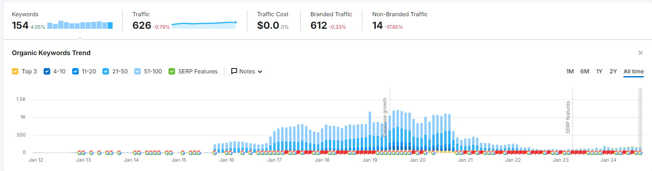
Project analysis slide 5
Keyword Research
Observation:
This image shows the top keywords that has been used by the Company.
Helps businesses understand what their target audience is searching for, enabling content creation that matches user intent and drives traffic.
Tools for Research: Google Keyword Planner, Semrush, SEO Optimer and Ubersuggest.
Two types of Keywords has been used:
Short-Tail Keywords with 1-2 words phrases with high search volume and Long-Tail Keywords with longer specific phrases with lower competiton but more target intended.
Incorporating keywords into title tags, meta descriptions, headings, and body content to improve organic search ranking.
Keyword research is an ongoing process; search trends change, and keywords need to be adjusted to maintain relevance.
Identifying which keywords competitors are ranking for and using them to inform your own strategy.
Analyzing seasonal trends and emerging terms to stay ahead of competitors and capitalize on search spikes.

Slide 14
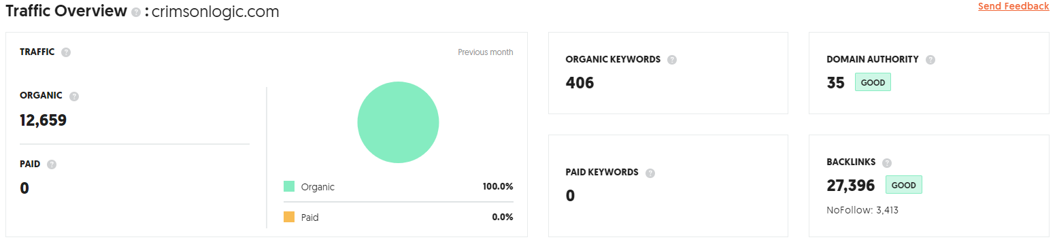
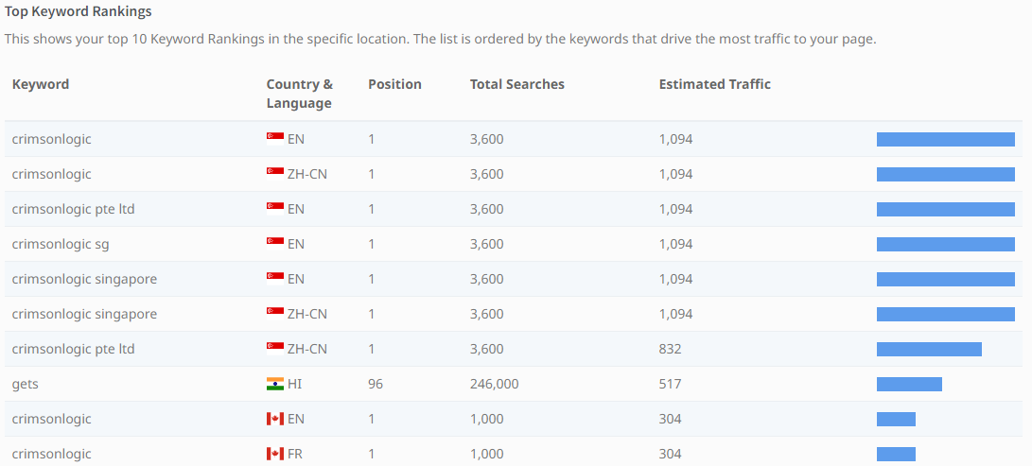
Project analysis slide 5
Keyword Research
Observation:
This image shows a detailed traffic overview and analysis of top keywords for crimsonlogic.com, highlighting its strong organic presence comes from using right keywords.
With 12,569 organic visits and zero paid traffic, it’s clear that the site relies entirely on organic search results.
The circular chart visually reinforces this, showing 100% organic traffic.
Additionally, the site boasts 406 organic keywords, a domain authority score of 35/100, and an impressive 27,396 backlinks, with 4.3% being No-Follow.
These metrics indicate a well-optimized site with a solid SEO foundation, driving significant organic traffic and maintaining a healthy backlink profile.

Slide 15
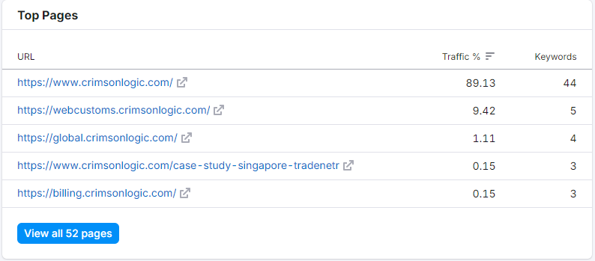
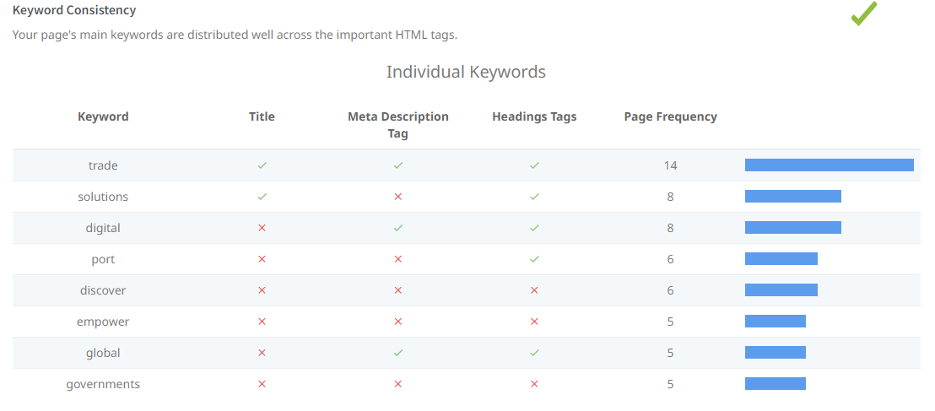
Project analysis slide 5
Keyword Research
Observation:
This web analytics dashboard showcases the “Top Pages” of a website, highlighting their performance in terms of traffic and keywords.
The first URL listed is the most visited, with a traffic percentage of 89.13% and 44 associated keywords.
The subsequent URLs show significantly lower traffic and fewer keywords, indicating less engagement.
This data is crucial for understanding which pages are driving the most traffic and can help in optimizing content and SEO strategies to improve overall website performance.
It shows how well the main keywords are distributed across important HTML tags like the Title, Meta Description, and Headings.
The chart also includes a bar graph indicating the frequency of each keyword on the page.
This kind of analysis is crucial for optimizing a website’s SEO, ensuring that the most important keywords are effectively utilized to improve search engine rankings.

Slide 16
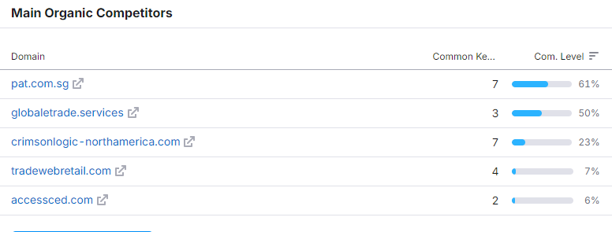
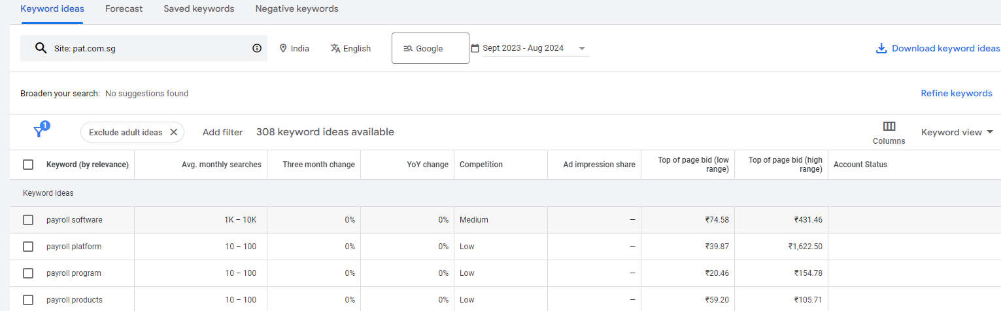
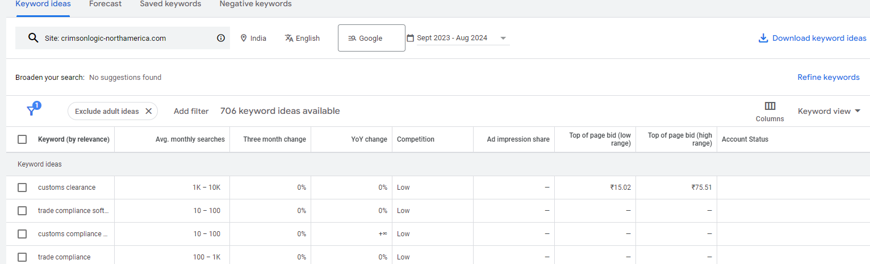
Project analysis slide 5
Keyword Research
Observation:
This image shows a table titled “Main Organic Competitors,” which appears to be from the SEO analysis report.
The table lists five domain names: pat.com.sg, global-trade.services, crimsonlogic-northamerica.com, tradewebratetail.com, and accessced.com.
For each domain, it provides the number of common keywords shared with the user’s website and a competition level percentage.
This information is valuable for understanding which websites are competing for similar keywords, helping businesses to refine their SEO strategies and improve their search engine rankings.
By analysing these competitors, businesses can identify opportunities to optimize their content and potentially outrank their competition.
Also we can see that some of the competitors keywords search report.

Slide 17
Project analysis slide 5
On-Page SEO Audit
Select at least 3 pages from the chosen website, conduct an on-page SEO audit, and share a report for each page using the following checklist:
Check title tags, meta descriptions, and HTML tags.
Ensure proper use of keywords in content and headings.
Improve internal linking and External structure.
Optimize images with alt texts and descriptive file names.

Slide 18
Project analysis slide 5
On-Page SEO Audit
Basics
Technical
Optimization
Site Indexed or Not?
Call-to-Action included or Not?
Necessary Pages exist or Not?
SSL certificate used or Not?
SSL redirect or Not?
Is site mobile friendly?
Mobile Speed?
Sitemap available or not?
Robots.txt available or not?
How many pages has thin contents?
Meta Title Tag?
Meta Descriptions?
URL?
H1 Tags?
Canonical Tags?
Image Alt Tags?

Slide 19
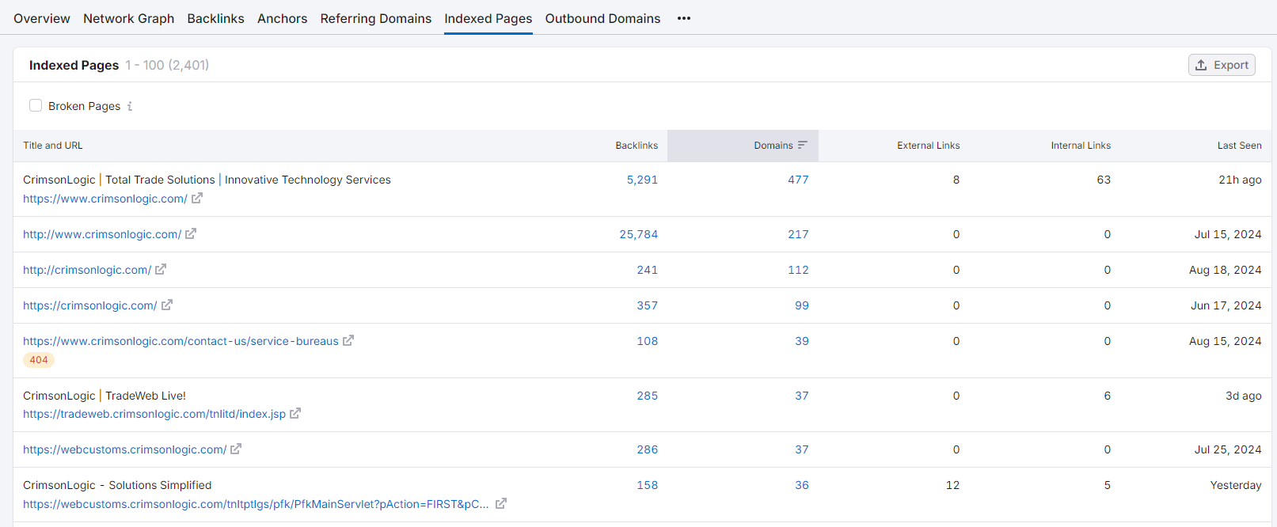
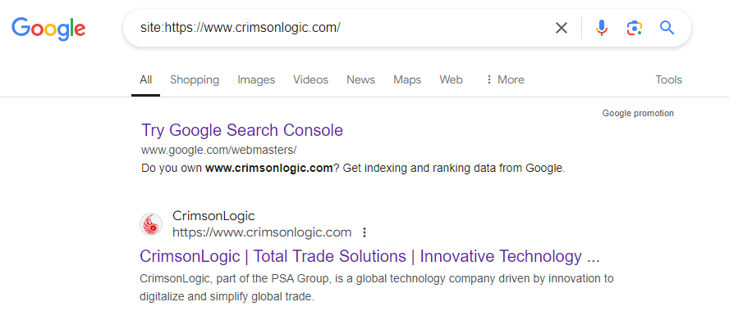
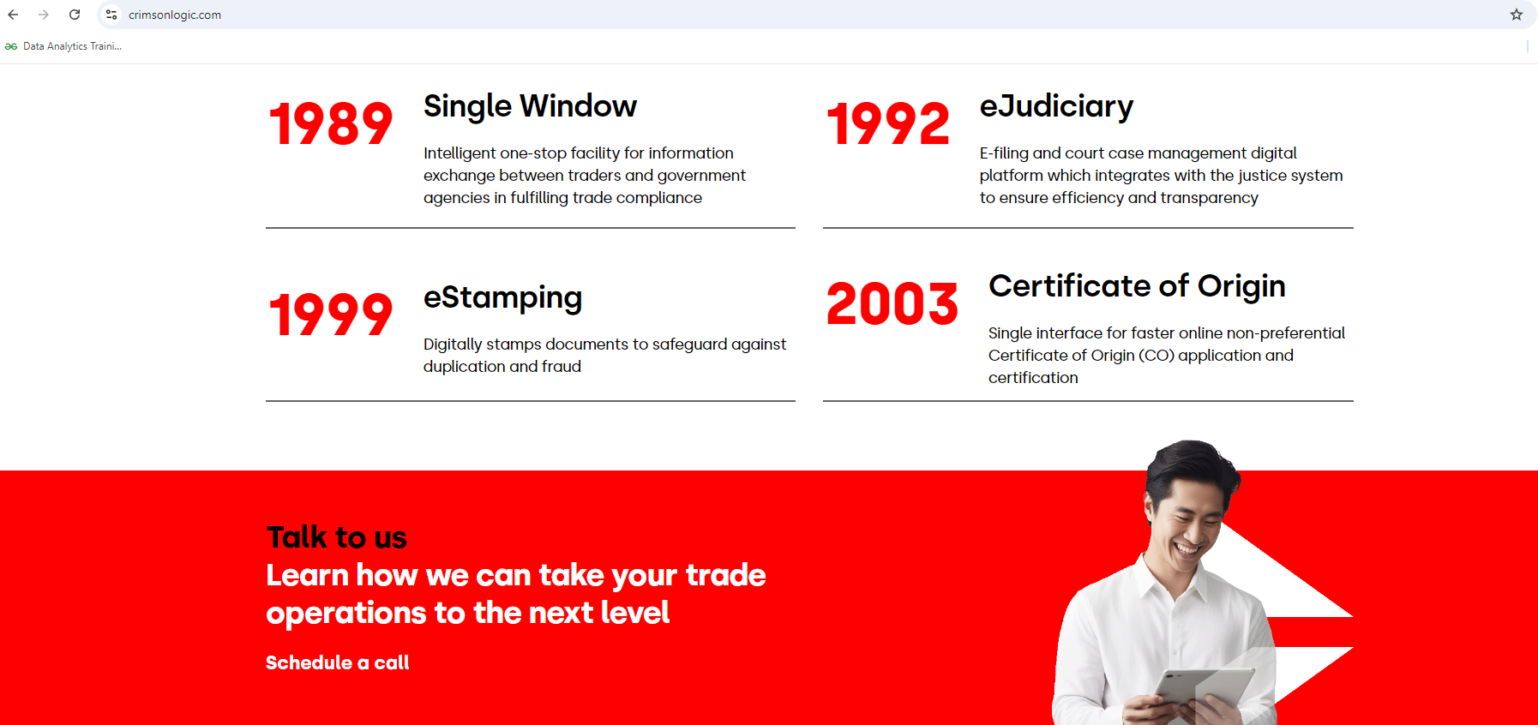
Project analysis slide 5
Basics
Is Site Indexed or Not?
Call-to-Action available or Not?

Slide 20
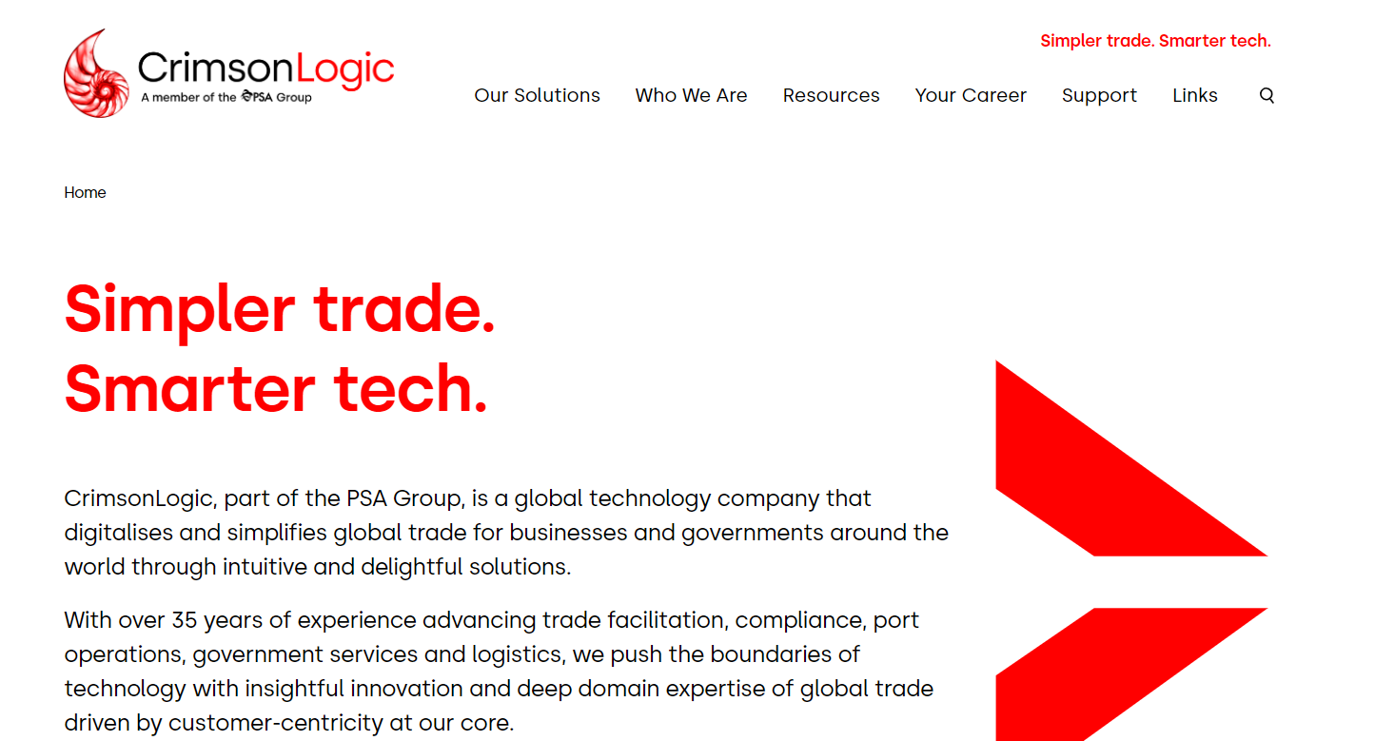
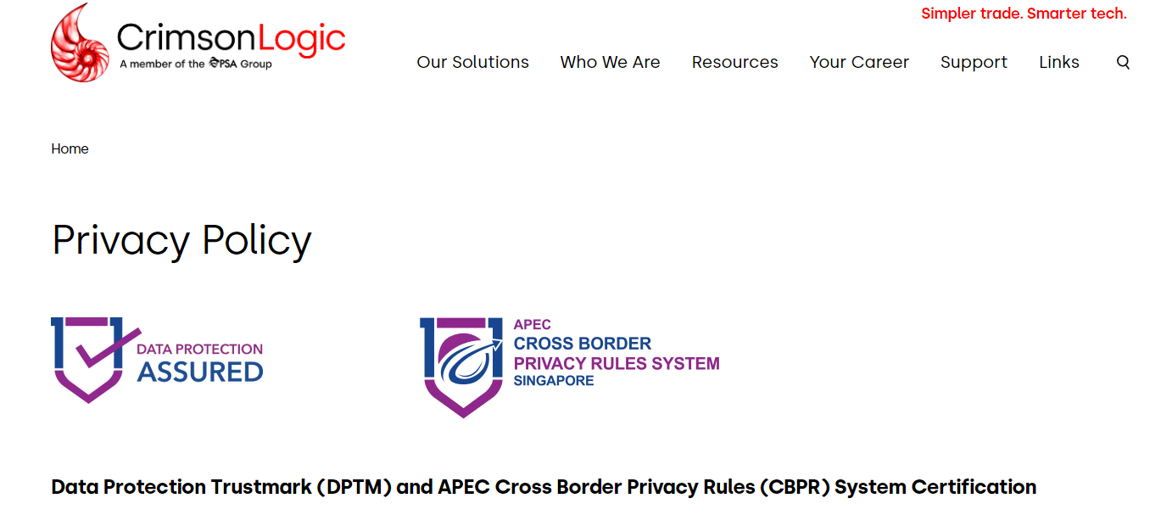
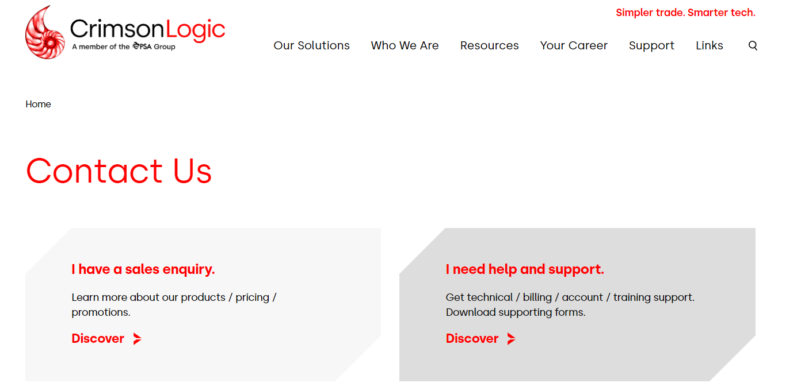
Project analysis slide 5
Basics
Is Necessary Pages available or Not?
About Us – Yes
Services – Yes
Privacy Policy - Yes
Home Page
Privacy Policy
Contact Us

Slide 21
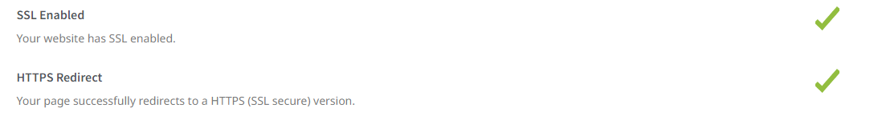
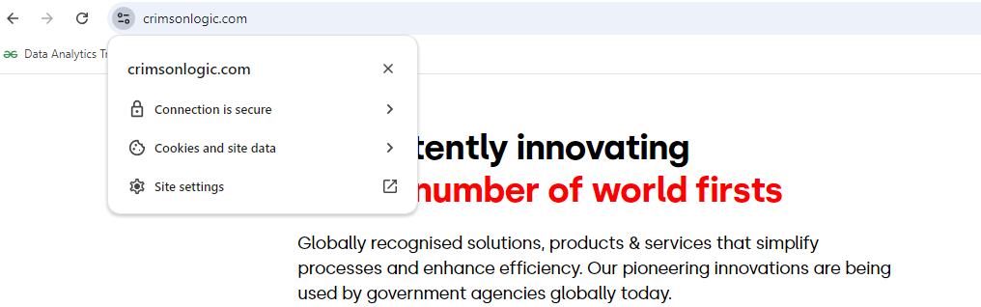
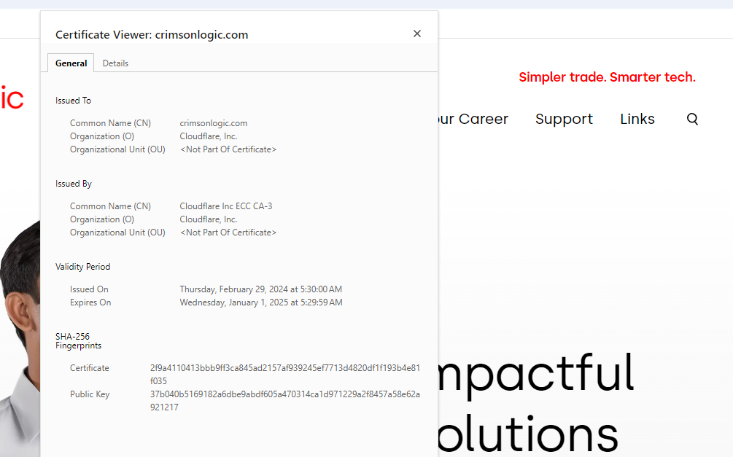
Project analysis slide 5
Basics
Is SSL Certificate used or not?
Yes if it has lock screen, then
It is https: enabled site.
Is SSL redirect is used or not?
- Yes it is used.

Slide 22
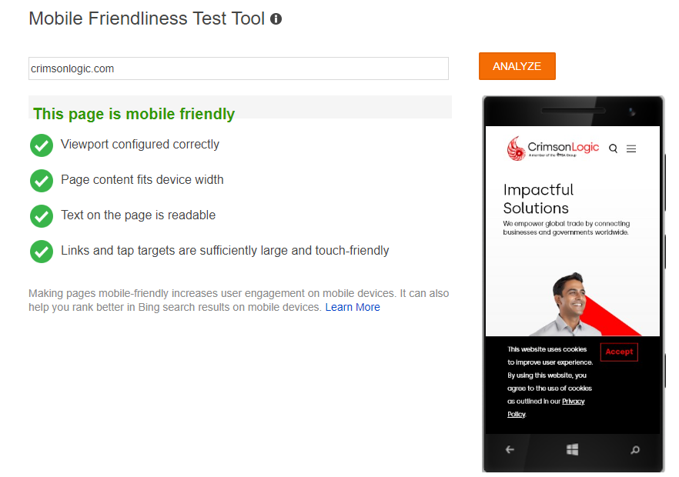
Project analysis slide 5
Basics
Is Site mobile friendly?
Yes it is.

Slide 23
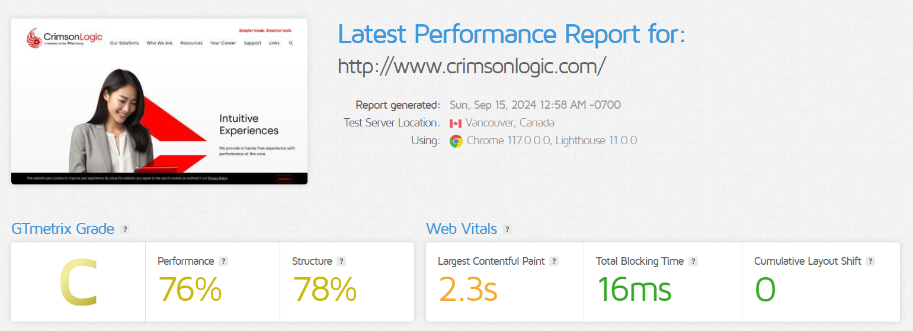
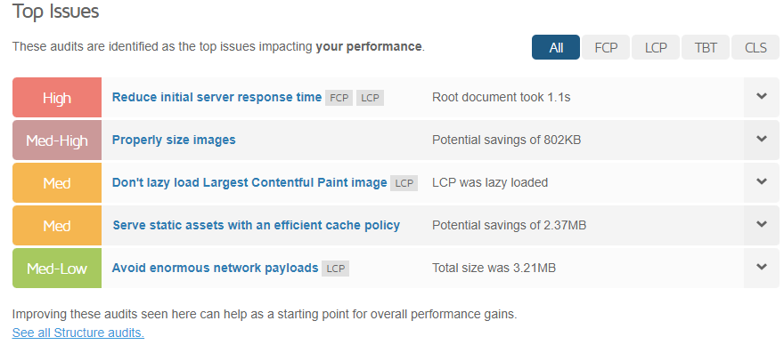
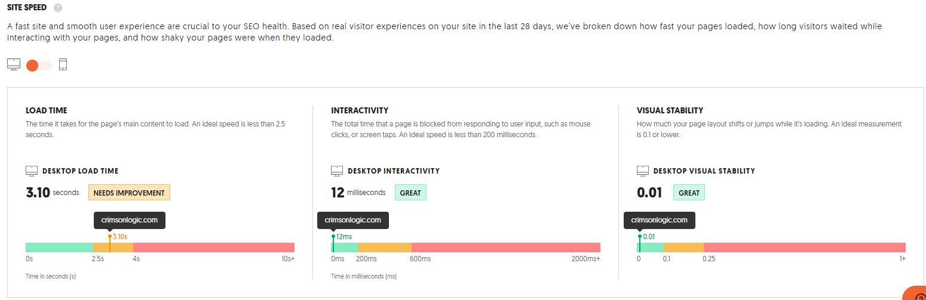
Project analysis slide 5
Basics
If yes, then what it is speed?
- Yes it is used.

Slide 24
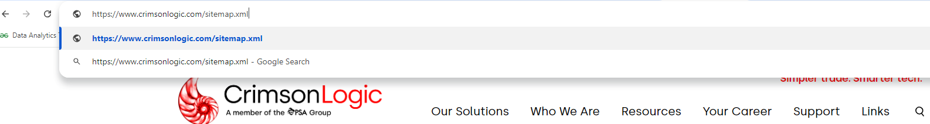
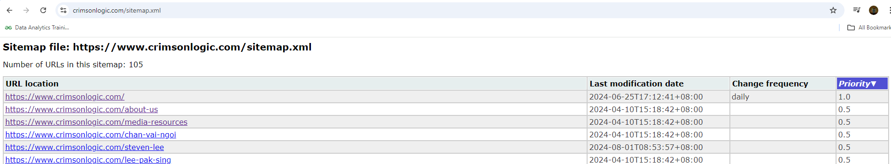
Project analysis slide 5
Technical
If Site Map available or not?
- Yes. Search engines like Google use to crawl and re-crawl posts/pages/product/images/archives on your website.

Slide 25
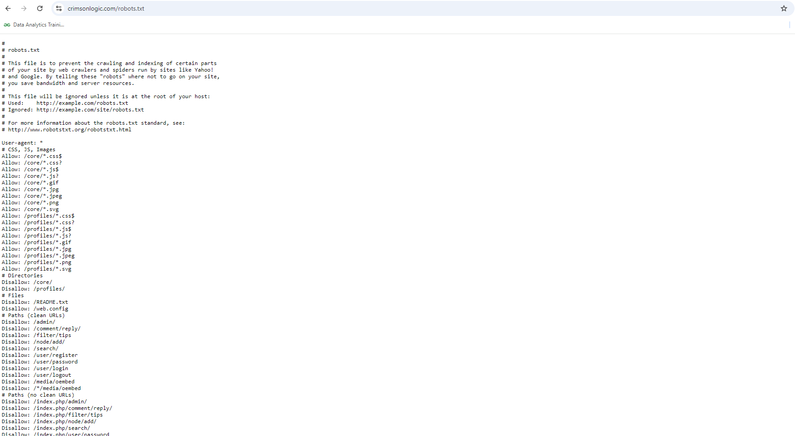
Project analysis slide 5
Technical
If Robots. Txt available or not?
- Yes, this file is to prevent the crawling and indexing of certain parts of your site by web crawlers and spiders run by sites.

Slide 26
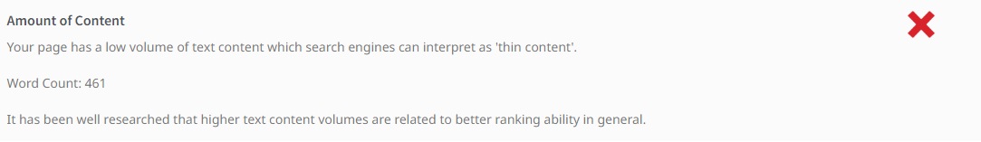
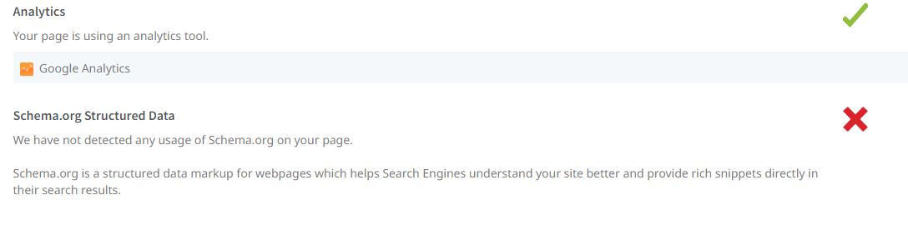
Project analysis slide 5
Technical
How many pages has thin content?
- Yes .
Does site have Analytics Tracker?
- Yes .

Slide 27
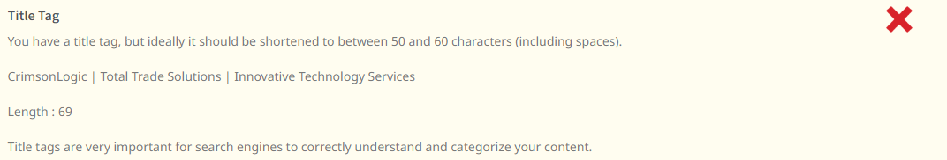
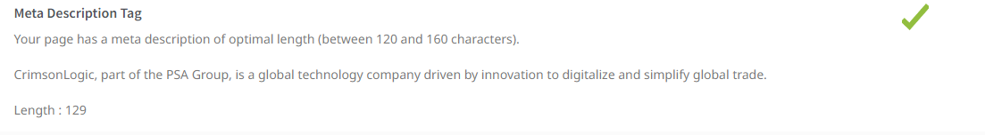
Project analysis slide 5
Optimization
Is Meta Title Tag available?
- Yes .
Is Meta descriptions available?
- Yes .

Slide 28
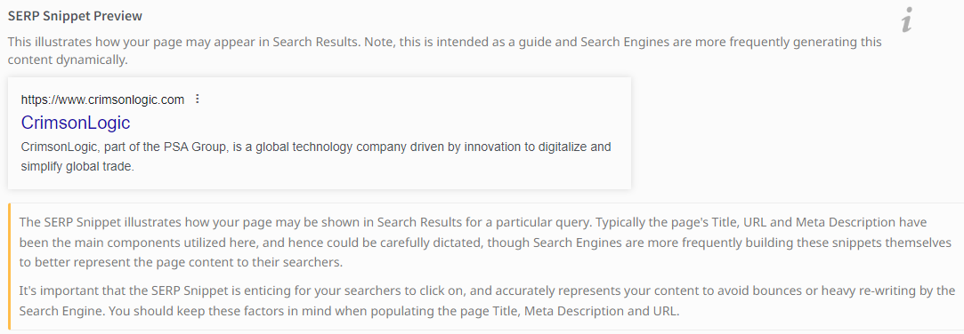
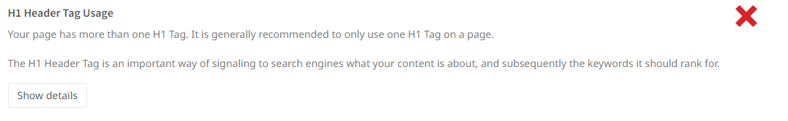
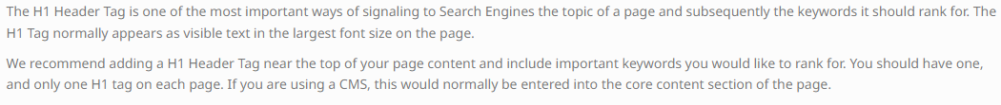
Project analysis slide 5
Optimization
SERP Snippet Preview?
- Yes .
Is Site using H1 Tags?
- Yes .

Slide 29

Project analysis slide 5
Optimization
Is site having any Image missing Alt attributes?
- No, the site is perfect.
Is Site using Canonical Tags?
- Yes .

Slide 30
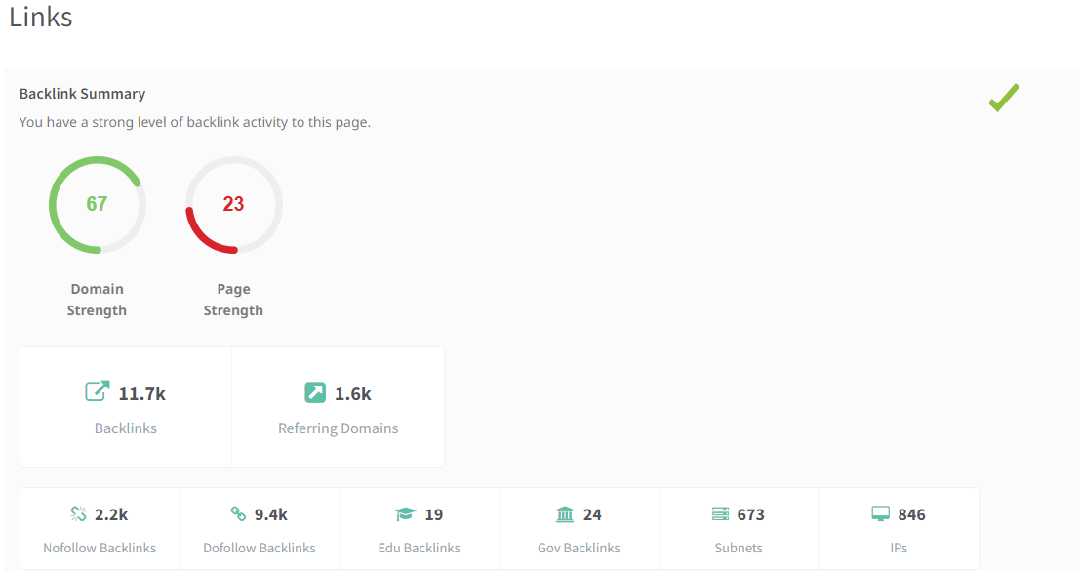
Project analysis slide 5
Optimization
Is site having backlinks correctly installed?
- Yes, the site has backlinks well used.

Slide 31
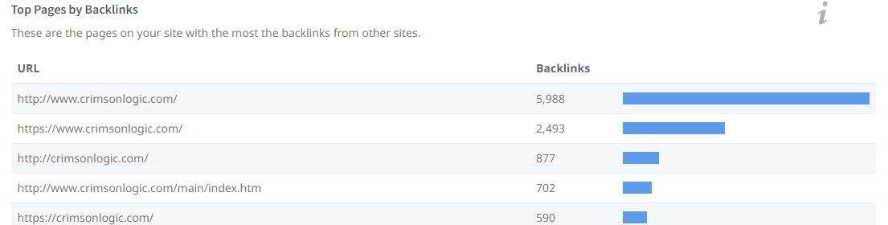
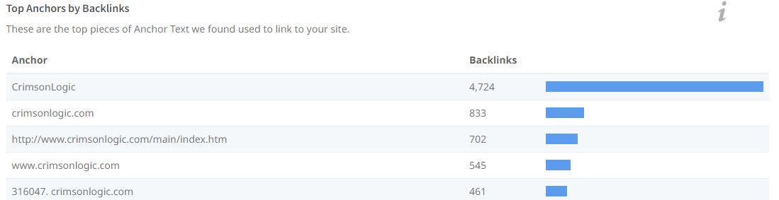
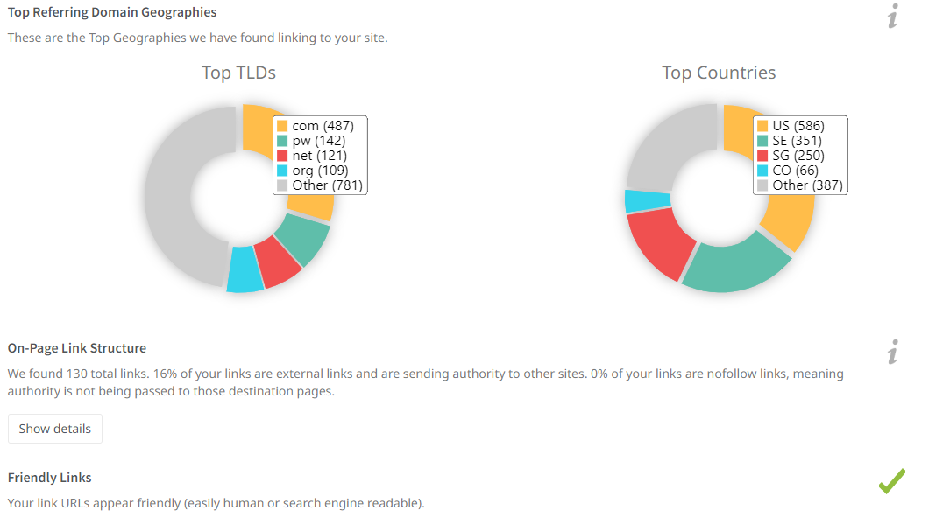
Project analysis slide 5
Optimization

Slide 32
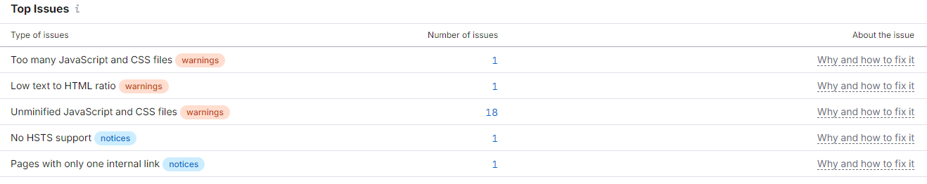
Project analysis slide 5
Technical SEO
Analysis of current technical SEO status:
Issue 1: Too many JavaScript and CSS files: This issue is triggered if a webpage uses more than a hundred JavaScript and CSS files. Each time a visitor navigates to a webpage, their browser first starts loading supportive files, such as JavaScript and CSS. For each file used by your webpage, a browser will send a separate HTTP request. Each request increases your page load time and affects its rendering, which has a direct impact on user experience, bounce rate and, ultimately, search engine rankings.
Solution: Review your pages to make sure that they only contain necessary JavaScript and CSS files. If all resources are important for your page, we recommend that you combine them.
Category: Site Performance.

Slide 33
Project analysis slide 5
Technical SEO
Analysis of current technical SEO status:
Issue 2: Low text to HTML ratio: Your text to HTML ratio indicates the amount of actual text you have on your webpage compared to the amount of code. This issue is triggered when your text to HTML is 10% or less. Search engines have begun focusing on pages that contain more content. That's why a higher text to HTML ratio means your page has a better chance of getting a good position in search results. Less code increases your page's load speed and also helps your rankings. It also helps search engine robots crawl your website faster.
Solution: Review your pages to make sure that they only contain necessary JavaScript and CSS files. If all resources are important for your page, we recommend that you combine them.
Category: Indexability.

Slide 34
Project analysis slide 5
Technical SEO
Analysis of current technical SEO status:
Issue 3: Un-minified JavaScript and CSS files: Minification is the process of removing unnecessary lines, white space and comments from the source code. Minifying JavaScript and CSS files makes their size smaller, thereby decreasing your page load time, providing a better user experience and improving your search engine rankings.
Solution: Minify your JavaScript and CSS files. If your webpage uses CSS and JS files that are hosted on an external site, contact the website owner and ask them to minify their files. If this issue doesn't affect your page load time, simply ignore it.
Category: Site Performance.

Slide 35
Project analysis slide 5
Technical SEO
Analysis of current technical SEO status:
Issue 4: No HSTS Support: HTTP Strict Transport Security (HSTS) informs web browsers that they can communicate with servers only through HTTPS connections. So, to ensure that you don't serve unsecured content to your audience, we recommend that you implement HSTS support.
Solution: Use a server that supports HSTS.
Category: Security and HTTPS.

Slide 36
Project analysis slide 5
Technical SEO
Analysis of current technical SEO status:
Issue 5: Pages with only one Internal link: Having very few incoming internal links means very few visits, or even none, and fewer chances of placing in search results. It is a good practice to add more incoming internal links to pages with useful content. That way, you can rest assured that users and search engines will never miss them.
Solution: Add more incoming internal links to pages with important content.
Category: Links, Crawlability.

Slide 37
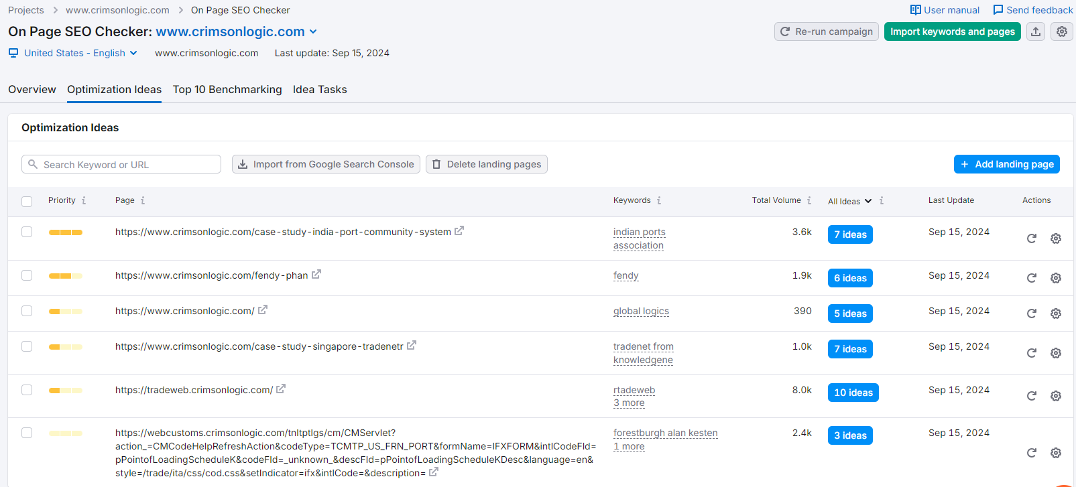
Project analysis slide 5
Content Strategy
Optimization Issues:

Slide 38
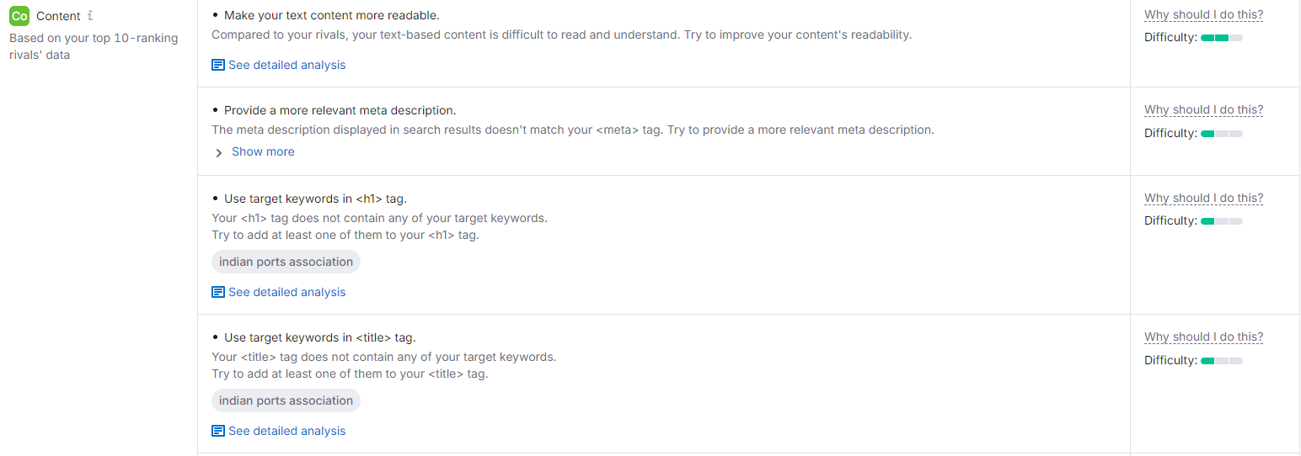
Project analysis slide 5
Content Strategy
Optimization Issues:

Slide 39
Project analysis slide 5
Content Strategy
Issue 1: Make your text content more readable.
Solution: Reading online is hard. Lengthy and overly complicated texts can make users stop reading your content and click away from a page that you'd like to promote in search results. Consequently, this leads to a higher bounce rate, which will negatively affect your SEO. Because search engines are becoming more focused on user behaviour, you definitely want your audience to stay on your page longer. For this reason, you should make sure that your text is easy to readable. We use the Flesch-Kincaid readability score to determine the readability of your text-based content.
Issue 2: Provide a more relevant meta description.
Solution: The ultimate goal of search engines is to provide users with the most relevant search results. As a result, if your meta description doesn’t meet certain requirements, search engines may decide to change it. Although this change shouldn’t affect your rankings, it may serve as an indication that your meta description doesn’t accurately reflect your page’s content and you should improve it.

Slide 40
Project analysis slide 5
Content Strategy
Issue 3: Use targeted keyword in <H1> tag.
Solution: If search engines don't find your target keyword in the <h1> tag of your page, they may rank it lower than they would otherwise.
Issue 4: Use targeted keyword in title tag.
Solution: A <title> tag is a key on-page SEO element that helps search engines understand what your page is about, and users will see it in search results. A page that contains relevant keywords in its title tag has a better chance to ranking higher.

Slide 41
Project analysis slide 5
Content Strategy
Goal: Leverage keyword research to increase Crimson Logic's visibility in the digital space, drive traffic to their website, and enhance their thought leadership in global trade, digital government solutions, and port operations.
Understand the Audience and Search Intent
Targeted Audience:
Government entities (e.g., customs and ports authorities)
Trade-related businesses and logistics firms
Technology partners
Policy makers
Search Intent for Each Keyword:
Global Logics: Likely targeting companies seeking global logistics and technology solutions. Focus on technology-based logistics solutions and supply chain management.
Rtadeweb: This seems related to trade solutions or platforms. Create content around electronic trade platforms, trade facilitation, and digitization in global trade.
Tradenet from Knowledgene: Focus on TradNet solutions, custom clearance, digital trade ecosystems, and how Knowledgene (an AI-based technology) powers these processes.
Fendy: Explore the Fendy system (assuming this is a digital platform or product). Highlight its use cases in digital trade and logistics management.
Indian Ports Association: Content around digital transformation of ports, automation, and trade facilitation in India.

Slide 42
Project analysis slide 5
Content Strategy
2. Content Pillars Based on Keywords
Develop content around core themes that align with the keywords and Crimson Logic’s services:
a. Digital Transformation in Global Trade
Target Keywords: Global Logics, TradNet from Knowledgene
Content Ideas:
Blog post: “How Global Logistics is Changing with Technology: A Look at TradNet from Knowledgene”
Whitepaper: “Leveraging AI in Global Trade Logistics: The Power of Knowledgene”
Case study: “Digital Transformation of Customs and Port Clearance Using TradNet”
Webinar: “Digital Trade Ecosystems: Streamlining Global Trade with Technology”
b. Trade Facilitation Platforms
Target Keywords: Rtadeweb, TradNet from Knowledgene
Content Ideas:
Blog post: “Why Tradeweb Solutions are Crucial for Global Trade Facilitation”
Infographic: “The Evolution of Electronic Trade Platforms: From Paper to Rtadeweb”
Product Page: “Tradenet: A Comprehensive Digital Trade Solution Powered by Knowledgene”
Case study: “How Tradenet Reduced Trade Processing Time for Governments and Businesses”
c. Smart Ports and Digital Port Solutions
Target Keywords: Indian Ports Association, Global Logics
Content Ideas:
Blog post: “Digitizing Indian Ports: A Look at Collaboration with Indian Ports Association”
Whitepaper: “Smart Ports: How Indian Ports Are Using Technology to Improve Trade Efficiency”
Case study: “Crimson Logic’s Partnership with Indian Ports: Enabling Seamless Port Operations”
Video: “The Future of Ports: Automation and Digital Port Management with Crimson Logic”
d. AI and Automation in Trade Logistics
Target Keywords: Fendy, TradNet from Knowledgene
Content Ideas:
Blog post: “AI in Trade: How Fendy and Knowledgene Are Revolutionizing Logistics”
Product Page: “Fendy: The AI-Powered Platform for Global Trade Facilitation”
Case study: “Automating Global Logistics with Fendy: Reducing Time and Costs”
Webinar: “How AI is Reshaping the Future of Global Logistics and Trade”

Slide 43
Project analysis slide 5
Content Strategy
3. SEO Best Practices
To rank for these keywords, optimize each content piece with:
Title Tags and Meta Descriptions: Use the keywords in title tags, meta descriptions, and headers to boost organic visibility.
Internal Linking: Link between relevant content (e.g., from a blog post about TradNet to a case study on Knowledgene) to improve SEO and keep users engaged.
Keyword Clustering: Group related keywords together to create comprehensive content clusters. For example, a content hub focused on “Trade Facilitation Platforms” with posts, case studies, and whitepapers all interlinking.
Regular Updates: Continuously update content with emerging trends or changes in legislation that impact trade and logistics.
Conclusion:
By focusing on a content strategy that revolves around the identified keywords (global logics, rtadeweb, tradenet from knowledgene, fendy, indian ports association), Crimson Logic can strengthen its position as a leader in global trade and logistics solutions. Content should highlight the technological innovations, AI-driven platforms, and digital transformation of trade ecosystems that align with their products and services.

Slide 44
Project analysis slide 5
Off-Page SEO
Off-page SEO focuses on strategies implemented outside of the website to improve search engine rankings, drive traffic, and build brand authority. For CrimsonLogic, a global leader in e-Government solutions and digital trade platforms, the off-page SEO strategy should focus on enhancing its reputation, authority, and visibility in the digital space. Below is a detailed off-page SEO plan:
1. Link Building Strategy
Backlinks remain one of the most critical ranking factors. The strategy for CrimsonLogic should focus on earning high-quality backlinks from authoritative and relevant websites.
Industry-Specific Guest Blogging
Objective: Publish high-quality articles on relevant industry websites and blogs to get backlinks and drive traffic.
Target Websites:
Technology blogs related to digital government, trade, and logistics.
Government and trade publications (e.g., GovTech, TradeTech).
Logistics and customs management sites (e.g., Supply Chain Digital, Global Trade Magazine).
Websites of trade organizations like the World Customs Organization, Indian Ports Association, and ASEAN Trade
Facilitation.
Content Ideas:
Thought leadership pieces around global trade digitization, AI in logistics, and smart port solutions.
Case studies or success stories about digital trade ecosystems or partnerships with government entities.

Slide 45
Project analysis slide 5
Off-Page SEO
b. Collaborations and Partnerships
Objective: Develop partnerships with trade organizations, government entities, and logistics associations to earn backlinks.
Tactics:
Collaborate with organizations like World Trade Organization (WTO) or UNCTAD on research papers or digital trade workshops.
Participate in joint initiatives or case studies with Indian Ports Association or other ports globally to highlight digital port transformation and secure backlinks from their official websites.
Partner with academic institutions that focus on eGovernment or global trade to provide expert interviews or resources that result in backlinks.
c. PR and Press Releases
Objective: Get media coverage and backlinks from high-authority news outlets.
Tactics:
Publish press releases on platforms like PR Newswire, Business Wire, and GlobeNewswire for major product launches, trade solutions, or government partnerships.
Pitch stories to tech and trade-related publications like TechCrunch, VentureBeat, and Global Trade Magazine.
Highlight collaborations with government bodies and port authorities to get coverage on government-related platforms or portals like GovInsider or GovTech.

Slide 46
Project analysis slide 5
Off-Page SEO
d. Niche Business Directories
Objective: List CrimsonLogic on reputable niche directories to increase backlinks and brand visibility.
Target Directories:
Clutch.co (Technology providers)
G2 (Software solutions)
GoodFirms (Business services)
Crunchbase (Company profile)
Trade facilitation organizations: Directories and portals associated with trade and customs organizations globally.
e. Broken Link Building
Objective: Identify broken links on industry-relevant websites and offer CrimsonLogic content as a replacement.
Tactics:
Use tools like Ahrefs or SEMrush to find broken links on competitor sites or industry blogs.
Reach out to website owners offering updated, high-quality CrimsonLogic content that they can link to instead.

Slide 47
Project analysis slide 5
Off-Page SEO
2. Social Media Engagement
While social signals don’t directly impact SEO rankings, social media engagement can drive traffic, build authority, and increase link-building opportunities.
LinkedIn Thought Leadership
Objective: Build credibility and network with potential clients, partners, and thought leaders on LinkedIn.
Tactics:
Post regular updates on global trade innovations, eGovernment solutions, and logistics technology.
Engage in conversations and participate in LinkedIn groups related to government technology, port operations, and digital transformation.
Share case studies, success stories, and whitepapers to drive traffic back to the CrimsonLogic website.
b. Twitter for Industry News
Objective: Position CrimsonLogic as a key player in global trade and digital government conversations.
Tactics:
Tweet about industry trends, global trade updates, and government digital transformation news.
Engage with relevant hashtags like #eGovernment, #DigitalTrade, #SmartPorts, and #CustomsAutomation.
Share blog content and updates to attract attention from journalists, bloggers, and industry influencers.
c. YouTube Videos and Webinars
Objective: Educate users on complex solutions offered by CrimsonLogic through explainer videos and webinars.
Tactics:
Post case study videos, explainer videos on trade platforms like TradeNet, and insights on digital customs clearance.
Partner with influencers or industry leaders for webinars on topics like digital trade ecosystems or the impact of AI in logistics.

Slide 48
Project analysis slide 5
Off-Page SEO
3. Local SEO for Targeted Markets
Since CrimsonLogic works with government agencies and trade associations globally, optimizing for local search in specific countries and regions can be beneficial.
Local Business Listings
Objective: Enhance visibility in regions where CrimsonLogic operates or has partnerships.
Tactics:
Create and optimize Google My Business profiles for offices in key regions.
Ensure consistent NAP (Name, Address, Phone Number) citations across local business directories, including Google My Business, Bing Places, and regional directories.
b. Country-Specific PR
Objective: Gain backlinks and mentions from country-specific or regional news outlets and websites.
Tactics:
Publish press releases targeting regional media in countries where CrimsonLogic has significant partnerships, such as India (for the Indian Ports Association) or ASEAN member countries.
Pitch stories to local technology and trade journals about digital transformation projects CrimsonLogic is working on.

Slide 49
Project analysis slide 5
Off-Page SEO
4. Performance Monitoring and Adjustments
Regularly monitor the success of the off-page SEO efforts and adjust the strategy accordingly.
Backlink Monitoring
Objective: Track the quality and quantity of backlinks acquired.
Tools: Use Ahrefs, SEMrush, or Moz to monitor backlink growth and ensure there are no toxic links that could harm the website's rankings.
b. Referral Traffic
Objective: Measure the traffic driven to the website from external sources.
Tools: Use Google Analytics to track referral traffic from backlinks, social media, and syndication platforms.
Conclusion:
This off-page SEO plan for CrimsonLogic.com focuses on building authoritative backlinks, engaging with social media, leveraging brand mentions, and enhancing visibility through collaborations and partnerships. With consistent efforts, the site will improve its domain authority, drive targeted traffic, and strengthen its presence in global trade and e-Government solutions.

Slide 50
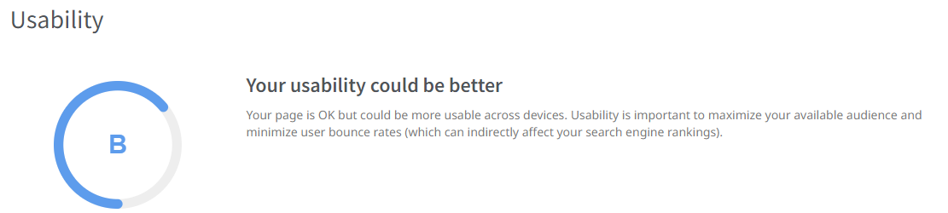
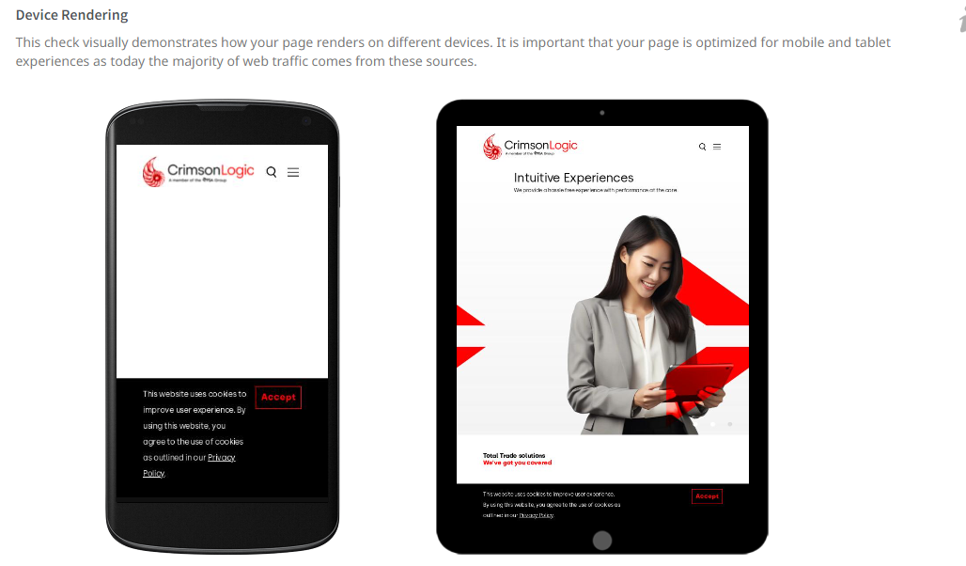
Project analysis slide 5
Usability

Slide 51
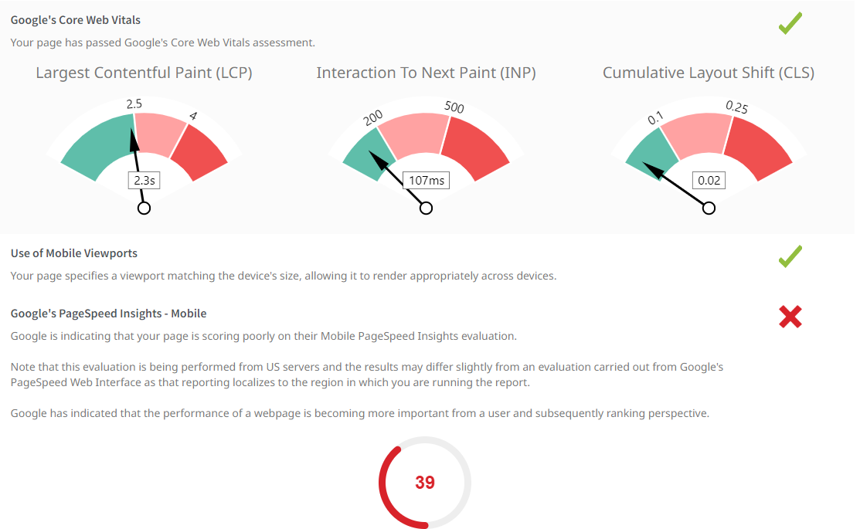
Project analysis slide 5
Usability
Mobile View

Slide 52
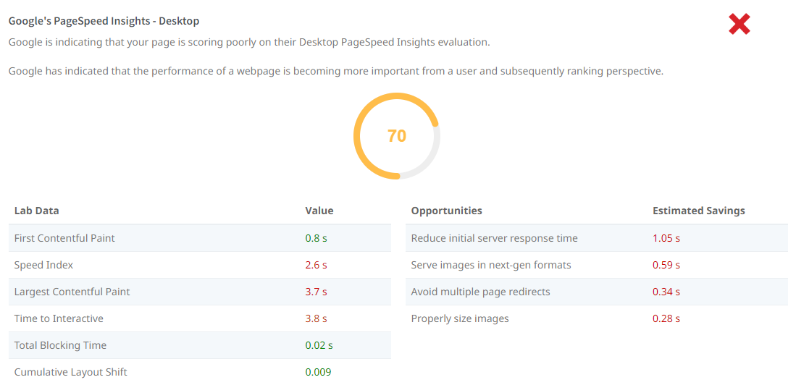
Project analysis slide 5
Usability
Desktop View

Slide 53

Project analysis slide 5
Performance

Slide 54

Project analysis slide 5
Performance

Slide 55

Project analysis slide 5
Performance

Slide 56

Project analysis slide 5
Social Results
Key Observations:
Facebook Page Linked:
Status: ❌ No Facebook page is associated or linked to the website.
Suggestion: Link an official Facebook page for better visibility.
Facebook Open Graph Tags:
Status: ✅ The website is using Facebook Open Graph Tags, which help enhance how shared links appear on Facebook.
Facebook Pixel:
Status: ❌ No Facebook Pixel detected on the website.
Suggestion: Implement Facebook Pixel to track visitors and enable retargeting for future Facebook Ads campaigns.
X (formerly Twitter) Account Linked:
Status: ❌ No associated X (formerly Twitter) profile linked on the website.
Suggestion: Link an official X account to improve visibility and engagement on that platform.
X Cards:
Status: ✅ The website is using X Cards, which optimize how content is displayed when shared on the platform

Slide 57


Project analysis slide 5
Technology Results

Slide 58



Project analysis slide 5
Traffic Analytics

Slide 59
Thank You

